Slide 1
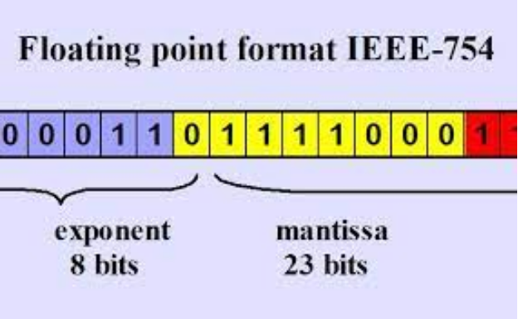
Unit 13.3 - Floating-Point Numbers
Prepared by: Koh Kian Hua

Slide 2
Objectives
After completing this unit, students should be able to:
Describe the format of binary floating-point real numbers
Convert binary floating-point real numbers into denary and vice versa
Normalise floating-point numbers
Understand the reasons for normalisation
Show understanding of the consequences of a binary representation only being an approximation to the real number it represents (in certain cases)
Understand how underflow and overflow can occur
Show understanding that binary representations can give rise to rounding errors

Slide 3
Floating-Point Numbers
Floating-Point Number Representation
Binary numbers can be stored in a fixedpoint representation.
The magnitude of the numbers stored depends on the number of bits used.
For example, 8 bits allowed a range of −128 to +127 (using two’s complement representation).
However, this type of representation limits the range of numbers and does not allow for fractional values.
To increase the range, and to allow for fractions, we can look to the method used in the denary number system.

Slide 4
Floating-Point Numbers
Floating-Point Number Representation
For example, 312 110 000 000 000 000 000 000 can be written as 3.1211 × 1023 using scientific notation.
If we adopt this system in binary, we get:
M × 2E
M is the mantissa and E is the exponent.
This is known as binary floating-point representation.

Slide 5
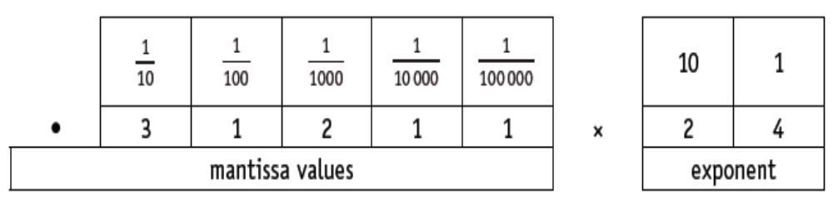
Floating-Point Numbers
Floating-Point Number Representation
We will assume a computer is using 8 bits to represent the mantissa and 8 bits to store the exponent (a binary point is assumed to exist between the first and second bits of the mantissa).
Again, using denary as our example, a number such as 0.31211 × 1024 means:

Slide 6
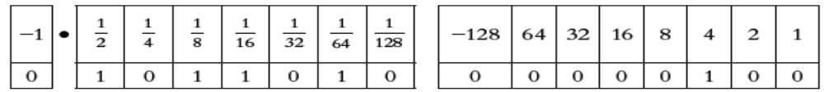
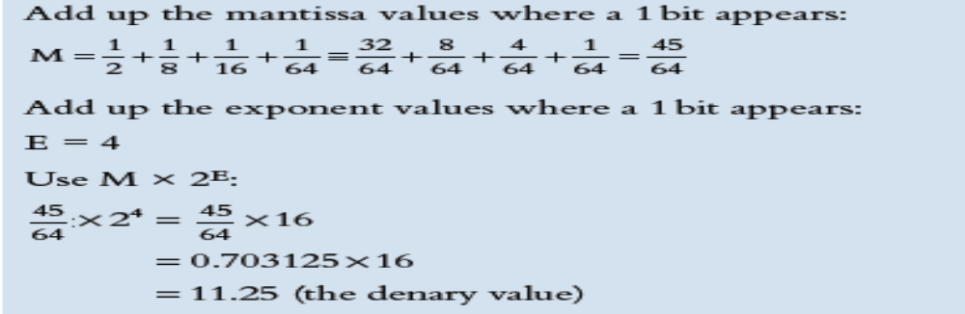
Floating-Point Numbers
Floating-Point Number Representation
Convert this binary floating-point number into denary.
Method 1

Slide 7
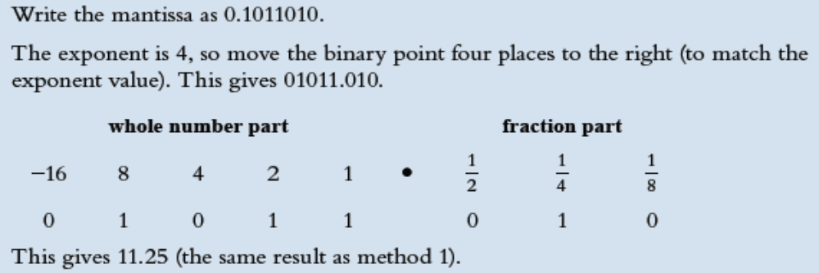
Floating-Point Numbers
Floating-Point Number Representation
Convert this binary floating-point number into denary.
Method 2

Slide 8
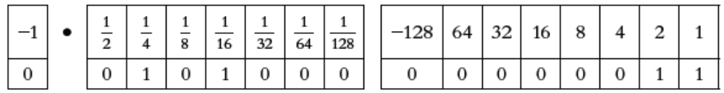
Floating-Point Numbers
Floating-Point Number Representation
Convert this binary floating-point number into denary.
Method 1

Slide 9
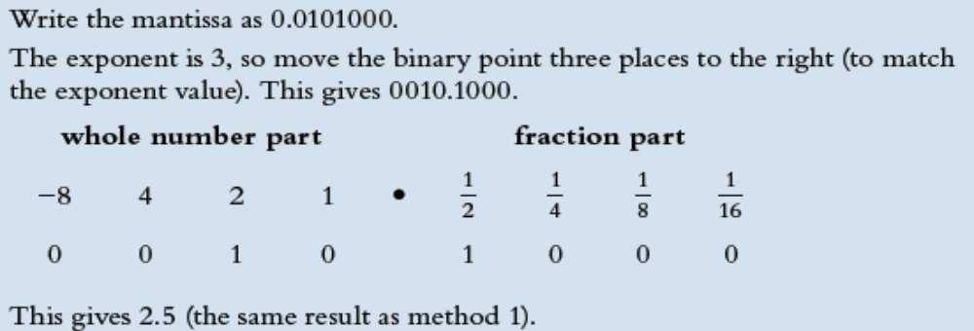
Floating-Point Numbers
Floating-Point Number Representation
Convert this binary floating-point number into denary.
Method 2:

Slide 10
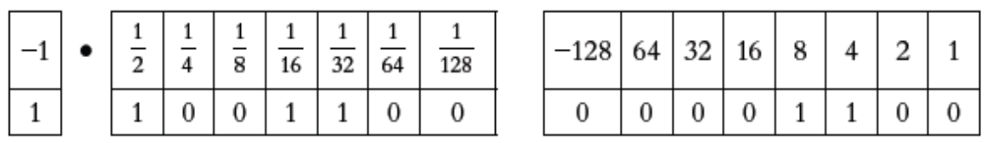
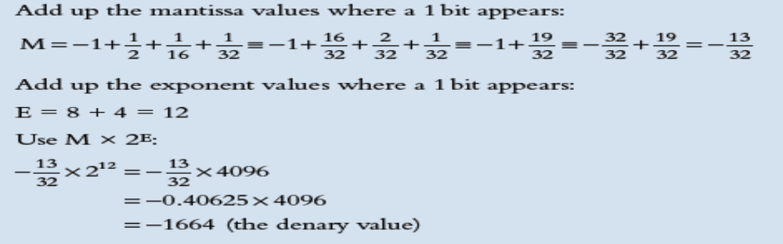
Floating-Point Numbers
Floating-Point Number Representation
Convert this binary floating-point number into denary.
Method 1:

Slide 11
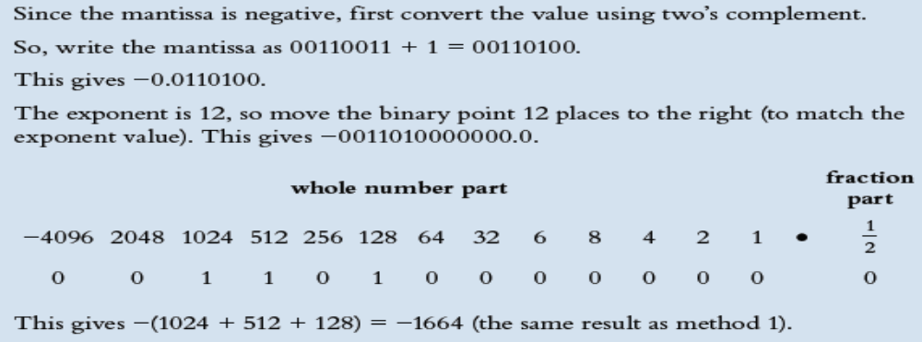
Floating-Point Numbers
Floating-Point Number Representation
Convert this binary floating-point number into denary.
Method 2:

Slide 12
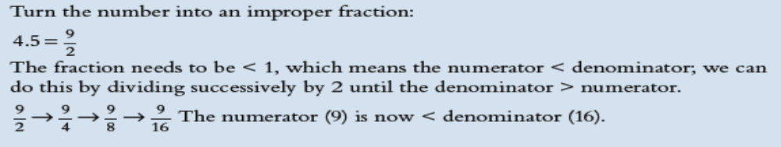
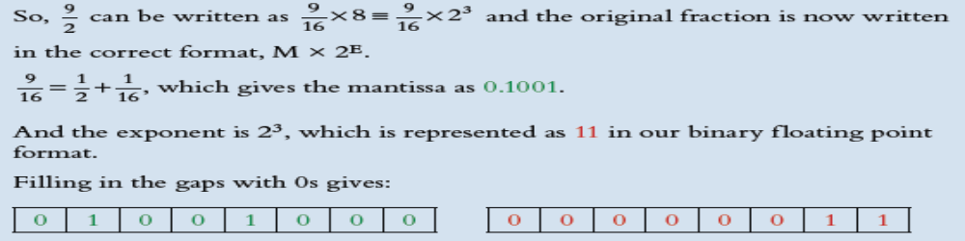
Floating-Point Numbers
Floating-Point Number Representation
Convert +4.5 into a binary f loating-point number.
Method 1:

Slide 13
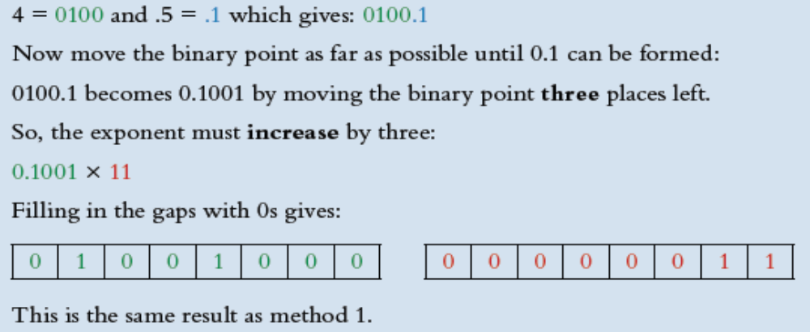
Floating-Point Numbers
Floating-Point Number Representation
Convert +4.5 into a binary f loating-point number.
Method 2:

Slide 14
Floating-Point Numbers
Floating-Point Number Representation
Convert +4.5 into a binary f loating-point number.
Method 2:

Slide 15
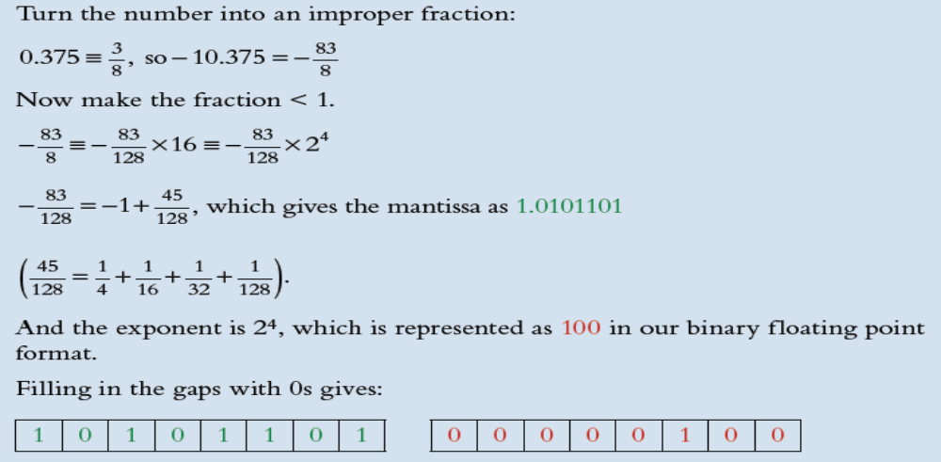
Floating-Point Numbers
Floating-Point Number Representation
Convert −10.375 into a binary floating-point number.
Method 1:

Slide 16
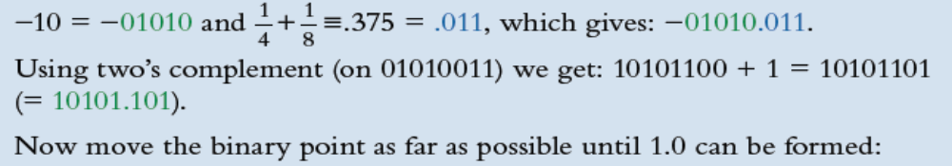
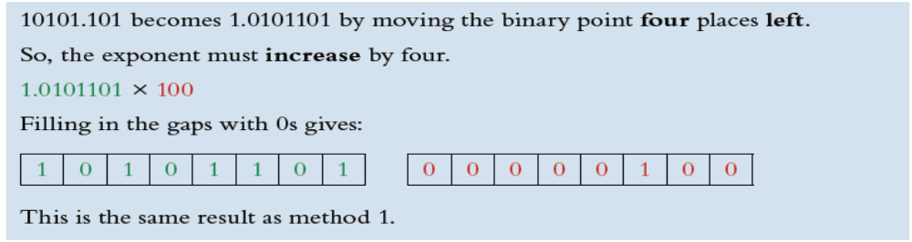
Floating-Point Numbers
Floating-Point Number Representation
Convert −10.375 into a binary floating-point number.
Method 2:

Slide 17
Floating-Point Numbers
Potential rounding errors and approximations
Convert −10.375 into a binary floating-point number.
The representation of the following example (denary number 5.88), using an 8-bit mantissa and 8-bit exponent, will lead to an inevitable rounding error since it is impossible to convert the denary number into an exact binary equivalent.
This error could be reduced by increasing the size of the mantissa; for example, a 16-bit mantissa would allow the number 5.88 to be represented as 5.875,which is a better approximation.

Slide 18

Floating-Point Numbers
Potential rounding errors and approximations
We will consider how to represent the denary number 5.88 using an 8-bit mantissa and 8-bit exponent.
To convert this into binary, we will use a method similar to that used in Chapter 1.
.88 × 2 = 1.76 so we will use the 1 value to give 0.1
.76 × 2 = 1.52 so we will use the 1 value to give 0.11
.52 × 2 = 1.04 so we will use the 1 value to give 0.111
.04 × 2 = 0.08 so we will use the 0 value to give 0.1110
.08 × 2 = 0.16 so we will use the 0 value to give 0.11100
.16 × 2 = 0.32 so we will use the 0 value to give 0.111000
.32 × 2 = 0.64 so we will use the 0 value to give 0.1110000
.64 × 2 = 1.28 so we will use the 1 value to give 0.11100001
We have to stop here since our system uses a maximum of 8 bits. Now the value of 5 (in binary) is 0101; this gives:
5.88 ≡ 0101.11100001
Moving the binary point as far to the left as possible gives:
0.1011100 × 23 (23 since the binary point was moved three places).
Thus, we get 0.1011100 00000011
(mantissa) (exponent)
So, 5.88 is stored as 5.75 in our floating-point system.

Slide 19
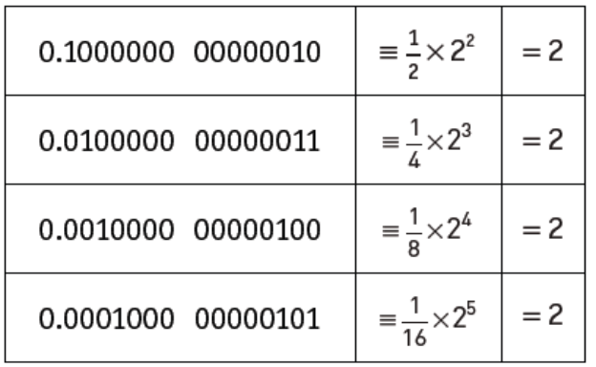
Floating-Point Numbers
Potential rounding errors and approximations
Consider this set of numbers.
As shown, there are several ways of representing the number 2. Using this sequence, if we kept shifting to the right, we would end up with:
This could lead to problems. To overcome this, we use a method called normalisation.

Slide 20
Floating-Point Numbers
Normalization
With this method, for a positive number, the mantissa must start with 0.1 (as in our first representation of 2 above).
  The bits in the mantissa are shifted to the left until we arrive at 0.1; for each shift left, the exponent is reduced by 1.
For a negative number the mantissa must start with 1.0.
  The bits in the mantissa are shifted until we arrive at 1.0; again, the exponent must be changed to reflect the number of shifts.

Slide 21

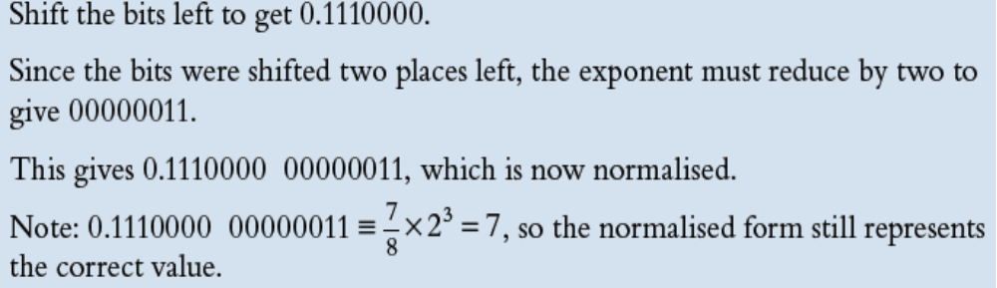
Floating-Point Numbers
Normalization (Example 1)

Slide 22
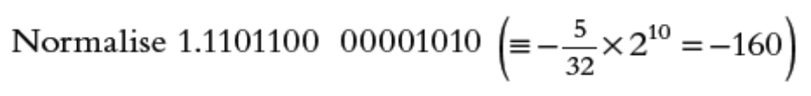
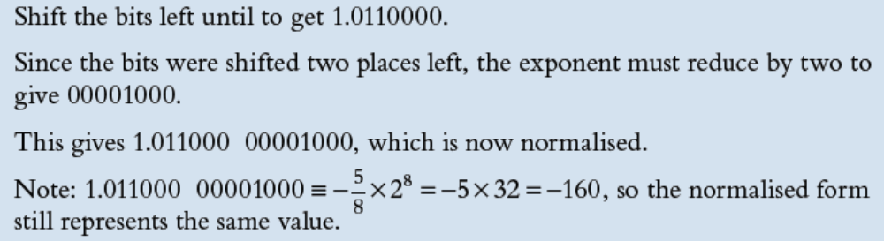
Floating-Point Numbers
Normalization (Example 2)

Slide 23
Floating-Point Numbers
Normalization (Example 2)

Slide 24
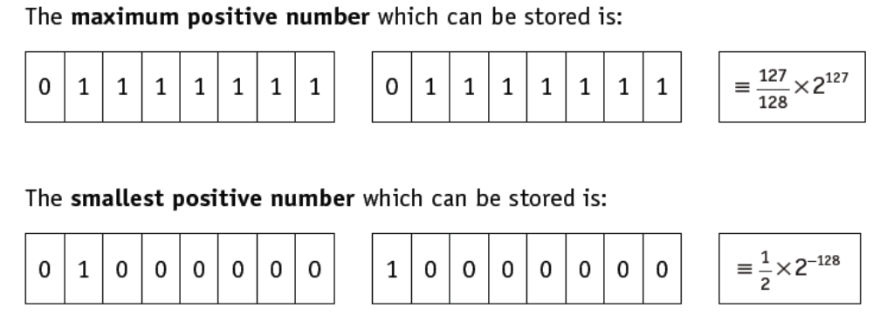
Floating-Point Numbers
Precision versus range
The following values relate to an 8-bit mantissa and an 8-bit exponent (using two’s complement):

Slide 25
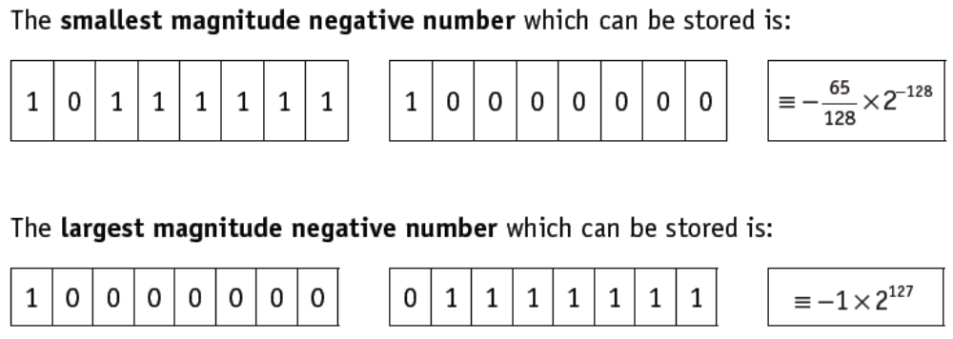
Floating-Point Numbers
Precision versus range
The following values relate to an 8-bit mantissa and an 8-bit exponent (using two’s complement):

Slide 26
Floating-Point Numbers
Precision versus range
The accuracy of a number can be increased by increasing the number of bits used in the mantissa.
The range of numbers can be increased by increasing the number of bits used in the exponent.
Accuracy and range will always be a trade-off between mantissa and exponent size.

Slide 27
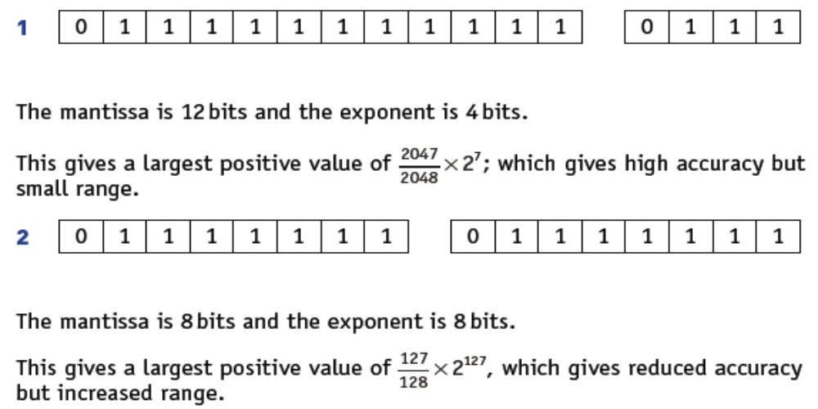
Floating-Point Numbers
Precision versus range
Consider the following 2 cases:

Slide 28
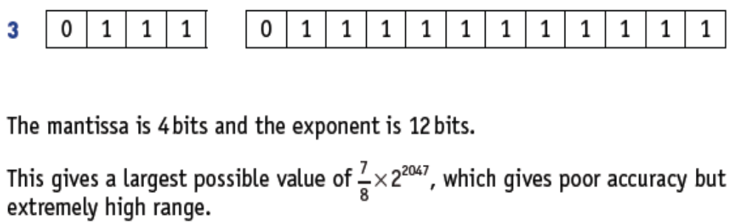
Floating-Point Numbers
Precision versus range
Consider the following cases:

Slide 29
Floating-Point Numbers
Floating-Point Problems
The storage of certain numbers is an approximation, due to limitations in the size of the mantissa.
This problem can be minimised when using programming languages that allow for double precision and quadruple precision.
There are additional problems:
If a calculation produces a number which exceeds the maximum possible value that can be stored in the mantissa and exponent, an overflow error will be produced. This could occur when trying to divide by a very small number or even 0.
When dividing by a very large number this can lead to a result which is less than the smallest number that can be stored. This would lead to an underflow error.
One of the issues of using normalised binary floating-point numbers is the inability to store the number zero. This is because the mantissa must be 0.1 or 1.0 which does not allow for a zero value.

Slide 30
Floating-Point Numbers
Homework
1) What is the largest positive and smallest magnitude number which can be stored in a computer using 10-bit mantissa and 6-bit exponent.
[5 Marks]
2) A computer uses 32 bits to store the mantissa and exponent. Discuss the precision and range of numbers which can be stored in this computer.
[5 Marks]

